Slide 1
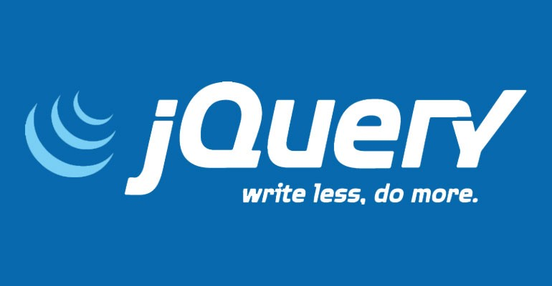

Slide 2
CSCI 1720
jQuery

Slide 4
What is jQuery?
jQuery is a lightweight, "write less, do more", JavaScript library
The purpose of jQuery is to make it much easier to use JavaScript on your website
jQuery takes a lot of common tasks that require many lines of JavaScript code to accomplish, and wraps them into methods that you can call with a single line of code
jQuery also simplifies a lot of the complicated things from JavaScript, like AJAX calls and DOM manipulation

Slide 5
What is jQuery?
The jQuery library contains the following features:
HTML/DOM manipulation
CSS manipulation
HTML event methods
Effects and animations
AJAX
Utilities

Slide 6
Will jQuery Work in all Browsers?
The jQuery team knows all about cross-browser issues, and they have written this knowledge into the jQuery library
jQuery will run exactly the same in all major browsers, including Internet Explorer 6!

Slide 7
Adding jQuery to Your Web Pages
Two methods:
Download - 2 versions
Production
Development
Both can be downloaded from jQuery.com (http://jquery.com/download/)

Slide 8
Adding jQuery to Your Web Pages
Two methods:
Download - 2 versions
Include in head element of pages:
Notes:
The path to the file may be different Notice the </script> tag

Slide 9
Adding jQuery to Your Web Pages
Two methods:
jQuery Content Delivery Network (CDN)
If you don't want to download and host jQuery yourself, you can include it from a CDN
Both Google and Microsoft host jQuery
To use jQuery from Google or Microsoft, use one of the following:

Slide 10
Adding jQuery to Your Web Pages
Two methods:
jQuery Content Delivery Network (CDN)
Google CDN:
Microsoft CDN:

Slide 11
Adding jQuery to Your Web Pages
Advantage of CDN over Download:
Many users already have downloaded jQuery from Google or Microsoft when visiting another site
As a result, it will be loaded from cache when they visit your site, which leads to faster loading time
Also, most CDNs will make sure that once a user requests a file from it, it will be served from the server closest to them, which also leads to faster loading time

Slide 12
jQuery Syntax
The jQuery syntax is tailor-made for selecting HTML elements and performing some action on the element(s)
Basic syntax is:
$(selector).action()
A $ sign to define/access jQuery
A (selector) to "query (or find)" HTML elements
A jQuery action() to be performed on the element(s)

Slide 13
jQuery Syntax
Examples:
$(this).hide() - hides the current element
$("p").hide() - hides all <p> elements
$(".test").hide() - hides all elements with class="test"
$("#test").hide() - hides the element with id="test"

Slide 14
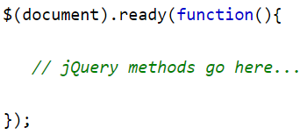
The Document Ready Event
all jQuery methods should appear inside a document ready event
This is to prevent any jQuery code from running before the document is finished loading (is ready)

Slide 15
The Document Ready Event
It is good practice to wait for the document to be fully loaded and ready before working with it
This also allows you to have your JavaScript code before the body of your document, in the head section
Examples of actions that can fail if methods are run before the document is fully loaded:
Trying to hide an element that is not created yet Trying to get the size of an image that is not loaded yet

Slide 16
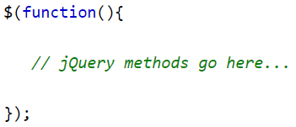
The Document Ready Event
Tip: The jQuery team has also created an even shorter method for the document ready event:
Use the syntax you prefer
The document ready event is easier to understand when reading the code

Slide 17
jQuery Selectors

Slide 18
jQuery Selectors
jQuery selectors allow you to select and manipulate HTML element(s)
jQuery selectors are used to "find" (or select) HTML elements based on their name, id, classes, types, attributes, values of attributes and much more
It's based on the existing CSS Selectors, and in addition, it has some own custom selectors
All selectors in jQuery start with the dollar sign and parentheses: $()

Slide 19
jQuery Selectors - The #id Selector
The jQuery #id selector uses the id attribute of an HTML tag to find the specific element
An id should be unique within a page, so you should use the #id selector when you want to find a single, unique element
To find an element with a specific id, write an octothorp, followed by the id of the HTML element:

Slide 20
jQuery Selectors - IDs
Javascript:
document.getElementById(“test”)…
vs. jQuery:
$(“#test”)

Slide 21
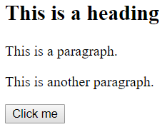
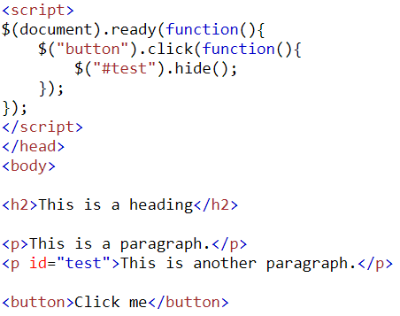
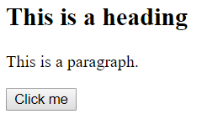
jQuery Selectors - IDs
Example:

Slide 22
jQuery Selectors - The Element Selector
The jQuery element selector selects elements based on the element name
You can select all <p> elements on a page like this:

Slide 23
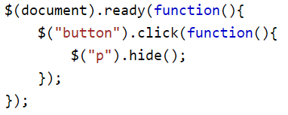
jQuery Selectors - The Element Selector
Javascript:
document.getElementByTagName(“p”)…
vs. jQuery:
$(“p”)…

Slide 24
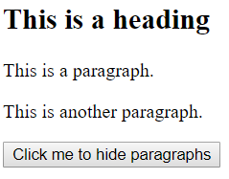
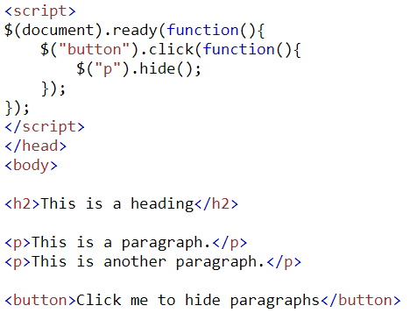
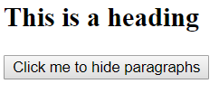
jQuery Selectors - The Element Selector
Example:

Slide 25
jQuery Selectors - The .class Selector
The jQuery class selector finds elements with a specific class
To find elements with a specific class, write a period character, followed by the name of the class:

Slide 26
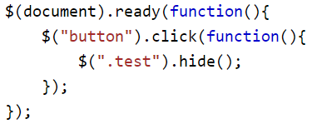
jQuery Selectors - The .class Selector
Javascript:
document.getElementByClassName(“test”)…
vs. jQuery:
$(“.test”)…

Slide 27
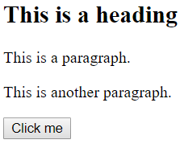
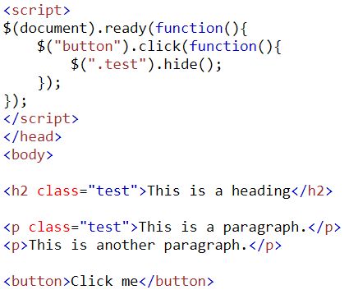
jQuery Selectors - The .class Selector
Example:

Slide 28
jQuery Selectors - More Examples
Syntax Description
$("*") Selects all elements
$(this) Selects the current HTML element
$("p.intro") Selects all <p> elements with class="intro"
$("p:first") Selects the first <p> element
$("ul li:first") Selects the first <li> element of the first <ul>
$("ul li:first-child") Selects the first <li> element of every <ul>
$("[href]") Selects all elements with an href attribute

Slide 29
jQuery Selectors - More Examples
Syntax Description
$("a[target='_blank']") Selects all <a> elements with a target attribute value equal to "_blank"
$("a[target!='_blank']") Selects all <a> elements with a target attribute value NOT equal to "_blank"
$(":button") Selects all <button> elements and <input> elements of type="button"
$("tr:even") Selects all even <tr> elements
$("tr:odd") Selects all odd <tr> elements

Slide 30
jQuery Functions In a Separate File
If your website contains a lot of pages, and you want your jQuery functions to be easy to maintain, you can put your jQuery functions in a separate .js file
In the examples here, the functions are added directly into the <head> section
However, sometimes [often] it is preferable to place them in a separate file, like this (use the src attribute to refer to the .js file):

Slide 31
jQuery Event Methods

Slide 32
What are Events?
All the different visitor's actions that a web page can respond to are called events
An event represents the precise moment when something happens
Examples:
Moving a mouse over an element
Selecting a radio button
Clicking on an element

Slide 33
What are Events?
The term "fires/fired" is often used with events
Example:
"The keypress event is fired, the moment you press a key"

Slide 34
What are Events?
Here are some common DOM events:
Mouse Events | Keyboard Events | Form Events | Document/ Window Events
click | keypress | submit | load
dblclick | keydown | change | resize
mouseenter | keyup | focus | scroll
mouseleave |  | blur | unload

Slide 35
jQuery Syntax For Event Methods
In jQuery, most DOM events have an equivalent jQuery method
To assign a click event to all paragraphs on a page, you can do this:

Slide 36
Commonly Used jQuery Event Methods
click()
The click() method attaches an event handler function to an HTML element
The function is executed when the user clicks on the HTML element
The following example says: When a click event fires on a <p> element; hide the current <p> element:

Slide 37
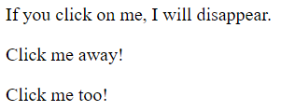
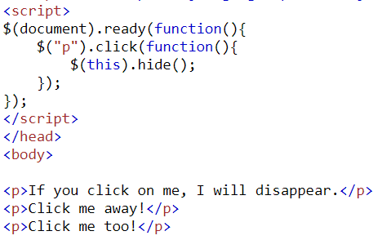
Commonly Used jQuery Event Methods
Example:

Slide 38
Commonly Used jQuery Event Methods
dblclick()
The dblclick() method attaches an event handler function to an HTML element
The function is executed when the user double-clicks on the HTML element:

Slide 39
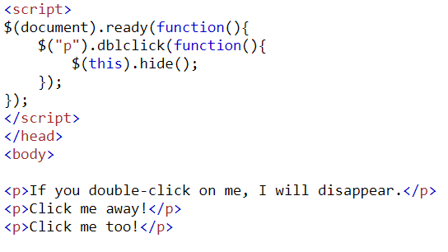
Commonly Used jQuery Event Methods
Example:

Slide 40
Commonly Used jQuery Event Methods
mouseenter()
The mouseenter() method attaches an event handler function to an HTML element.
The function is executed when the mouse pointer enters the HTML element:

Slide 41
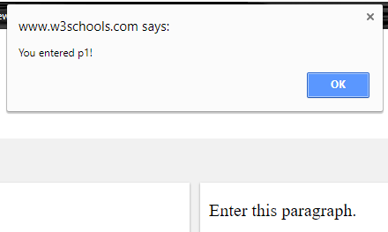
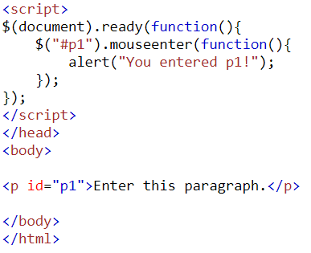
Commonly Used jQuery Event Methods
Example:

Slide 42
Commonly Used jQuery Event Methods
mouseleave()
The mouseleave() method method attaches an event handler function to an HTML element
The function is executed when the mouse pointer leaves the HTML element:

Slide 43
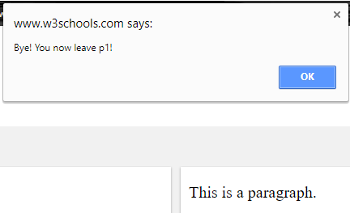
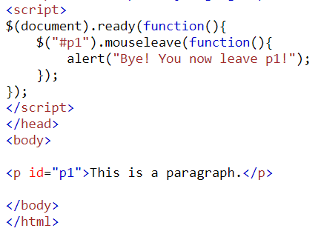
Commonly Used jQuery Event Methods
Example:

Slide 44
Commonly Used jQuery Event Methods
mousedown()
The mousedown() method method attaches an event handler function to an HTML element
The function is executed, when the left, middle or right mouse button is pressed down, while the mouse is over the HTML element:

Slide 45
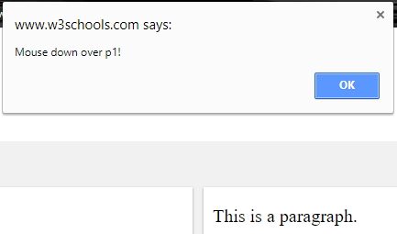
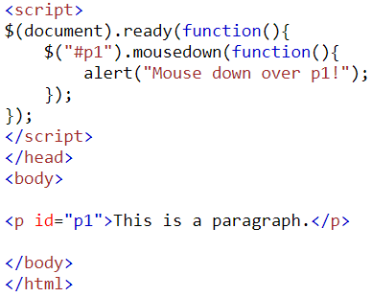
Commonly Used jQuery Event Methods
Example:

Slide 46
Commonly Used jQuery Event Methods
mouseup()
The mouseup() method method attaches an event handler function to an HTML element
The function is executed, when the left, middle or right mouse button is released, while the mouse is over the HTML element:

Slide 47
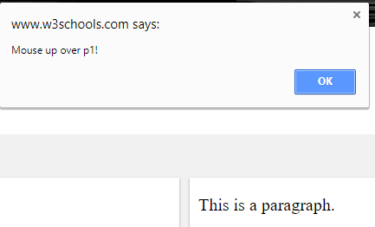
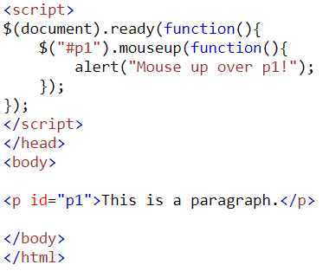
Commonly Used jQuery Event Methods
Example:

Slide 48
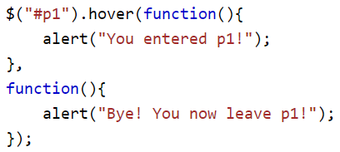
Commonly Used jQuery Event Methods
hover()
The hover() method takes two functions and is a combination of the mouseenter() and mouseleave() methods.
The first function is executed when the mouse enters the HTML element, and the second function is executed when the mouse leaves the HTML element:

Slide 49
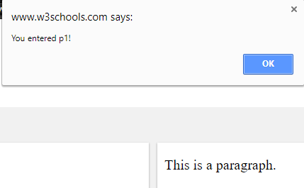
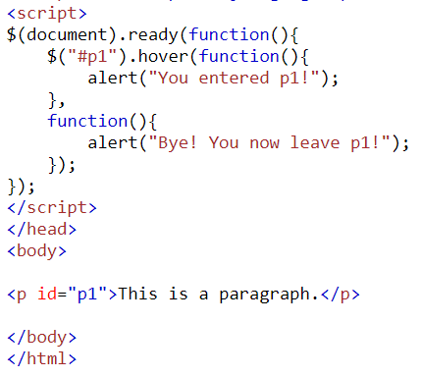
Commonly Used jQuery Event Methods
Example:

Slide 50
Commonly Used jQuery Event Methods
on()
The on() method attaches one or more event handlers for the selected elements.
Attach a click event to a <p> element:

Slide 51
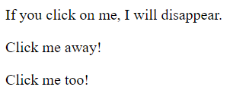
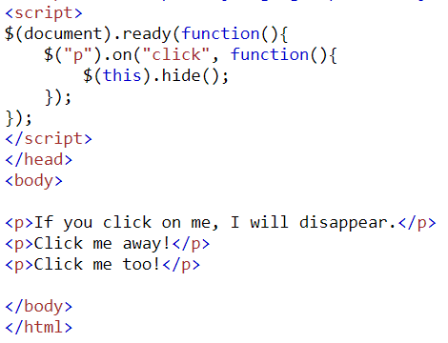
Commonly Used jQuery Event Methods
Example:

Slide 52
A note on constructing JavaScript/jQuery functions
Though this lecture features relatively simple functions to demonstrate several concepts, it should be obvious that the code can grow more complex in practice
I suggest (Since NPP and Brackets aren’t sophisticated to anticipate this) that you consider the old programmers (pre code-completion days) method of constructing them:

Slide 53
A note on constructing JavaScript/jQuery functions
First:
See how there’s an anonymous function nested inside the $(document).ready function?
So, get the punctuation right before cluttering it up with your code

Slide 54
A note on constructing JavaScript/jQuery functions
Then:
We then set up a second, nested ‘skeleton’, to tell the browser how to behave when the document is indeed ready

Slide 55
A note on constructing JavaScript/jQuery functions
Then:
We can, confident that all the parentheses, braces, and semicolons are properly nested, add the actual code to execute

Slide 56
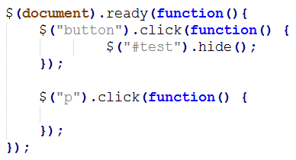
A note on constructing JavaScript/jQuery functions
Using the same method, we can add additional nested functions:
…and so on

Slide 57
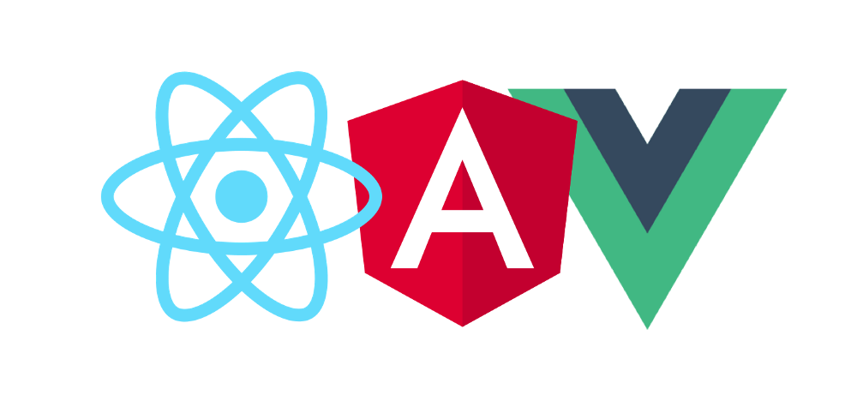
Scaffolding
A lot of current web-building technology is based on these basic concepts
There are a number of JavaScript frameworks available that also seek to eliminate the pain points associated with vanilla JavaScript

Slide 58
Scaffolding
All of them have their fanbases
Pros and cons
Focus on front-end – user-centric design
Learning each requires a sound grounding in vanilla JS
jQuery kind of ‘splits the difference’ between vanilla JS and JS frameworks
Library instead of framework
A little less complex

Slide 59
Copyrights
Presentation prepared by and copyright of John Ramsey, East Tennessee State University, Department of Computing . (ramseyjw@etsu.edu)
Microsoft, Windows, Excel, Outlook, and PowerPoint are registered trademarks of Microsoft Corporation.
IBM, DB2, DB2 Universal Database, System i, System i5, System p, System p5, System x, System z, System z10, System z9, z10, z9, iSeries, pSeries, xSeries, zSeries, eServer, z/VM, z/OS, i5/OS, S/390, OS/390, OS/400, AS/400, S/390 Parallel Enterprise Server, PowerVM, Power Architecture, POWER6+, POWER6, POWER5+, POWER5, POWER, OpenPower, PowerPC, BatchPipes, BladeCenter, System Storage, GPFS, HACMP, RETAIN, DB2 Connect, RACF, Redbooks, OS/2, Parallel Sysplex, MVS/ESA, AIX, Intelligent Miner, WebSphere, Netfinity, Tivoli and Informix are trademarks or registered trademarks of IBM Corporation.
Linux is the registered trademark of Linus Torvalds in the U.S. and other countries.
Oracle is a registered trademark of Oracle Corporation.
HTML, XML, XHTML and W3C are trademarks or registered trademarks of W3C®, World Wide Web Consortium, Massachusetts Institute of Technology.
Java is a registered trademark of Sun Microsystems, Inc.
JavaScript is a registered trademark of Sun Microsystems, Inc., used under license for technology invented and implemented by Netscape.
SAP, R/3, SAP NetWeaver, Duet, PartnerEdge, ByDesign, SAP Business ByDesign, and other SAP products and services mentioned herein as well as their respective logos are trademarks or registered trademarks of SAP AG in Germany and other countries.
Business Objects and the Business Objects logo, BusinessObjects, Crystal Reports, Crystal Decisions, Web Intelligence, Xcelsius, and other Business Objects products and services mentioned herein as well as their respective logos are trademarks or registered trademarks of Business Objects S.A. in the United States and in other countries. Business Objects is an SAP company.
ERPsim is a registered copyright of ERPsim Labs, HEC Montreal.
Other products mentioned in this presentation are trademarks of their respective owners.

